Slide 1
Den
Parent Guide

Slide 2
Parent Involvement
Fellow Parents,
While we strive to put on the very best program possible for our children. This will only be possible with your continued help and support.
We could really use assistant den leaders and people on the pack committee to support and help us with the operation of the den. If you can volunteer for these roles, it would be most appreciated.
Everyone will be called on throughout the year to assist us with various program activities. You may be asked to:
Drive to and from outings
Spend a night camping with your child
Assist in the pack meetings
Provide snacks
Organize and lead a special event (such as a trip to a museum, etc.)
Assist in the various pack events (pinewood derby, rain gutter regatta, space race, etc.)
We would much rather have volunteers rather than recruits, so please volunteer whenever possible. We really look forward to the coming year and making it one to remember for the youth.
Thanks for your continued support!
Chris

Slide 3
Aims of Scouting
All levels of the Scouting program share three specific objectives: Character development, Citizenship training, and Personal fitness.
Character
One is growth in moral strength and character. We may define this as what the youth is themself; their personal qualities, their values, their outlook.
Citizenship
A second is participating citizenship. Used broadly, citizenship means the youth's relationship to others. They comes to learn obligations to other people, to the society they live in, and to the government that presides over that society.
Fitness
A third aim of youth Scouting is development of physical, mental, and emotional fitness. Fitness includes the body (well-tuned and healthy), the mind (able to think and solve problems), and the emotions (self-control, courage, and self-respect).

Slide 4
Methods of Cub Scouting
1. The Ideals
The Cub Scout Promise, the Law of the Pack, and the Cub Scout sign, handshake, motto, and salute all teach good citizenship and contribute to a youth's sense of belonging.
2. The Den
youths like to belong to a group. The den is the place where youths learn new skills and develop interests in new things. They have fun in den meetings, during indoor and outdoor activities, and on field trips. As part of a small group of six to eight youths, they can learn sportsmanship and good citizenship. They learn how to have a good relationship with others. They learn how to do their best, not just for themselves but also for the den.
3. Advancement
Recognition is important to youths. The advancement plan provides fun for the youths, gives them a sense of personal achievement as they earn badges, and strengthens family understanding as adult family members work with youths on advancement projects.
4. Family Involvement
Family involvement is an essential part of Cub Scouting. When we speak of parents or families, we are not referring to any family structure. Some youths live with two parents, some live with one parent, some have foster parents, and some live with other relatives or guardians. Whoever a youth calls their family is their family in Cub Scouting.
5. Activities
In Cub Scouting, youths participate in a wide variety of den and pack activities, such as games, projects, skits, stunts, songs, outdoor activities, and trips. Also, the Cub Scout Academics and Sports program and Cub Scouting's BSA Family program include activities that encourage personal achievement and family involvement.
6. Home and Neighborhood Centered
Cub Scouting meetings and activities happen in urban areas, in rural communities, in large cities, in small towns—wherever youths live.
7. The Uniform
The Tiger Cub, Cub Scout, and Webelos Scout uniforms help build pride, loyalty, and self-respect. Wearing the uniform to all den and pack meetings and activities also encourages a neat appearance, a sense of belonging, and good behavior.

Slide 5
Uniform
The seventh method of Cub Scouting is the uniform. For the pack, the minimum is a shirt, hat, and insignia. Part of your annual dues is the neckerchief that we purchase and award at joining and at rank advancement. We encourage navy blue shorts/pants that can be purchased anywhere. Your scout will need a belt to wear their belt loop badges with pride. For Webelos and Arrow of Light Scouts, the khaki shirt with insignia and olive-green shorts/pants are worn. Again, the olive-green pants can be purchased anywhere.

Slide 6
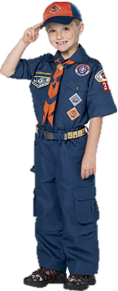
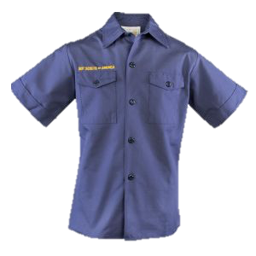
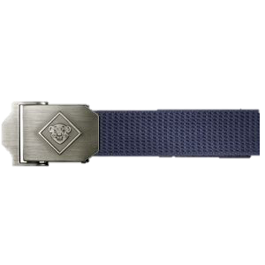
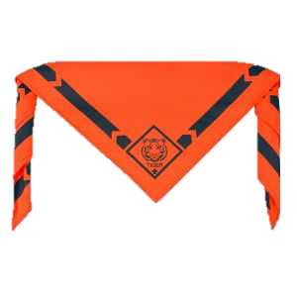
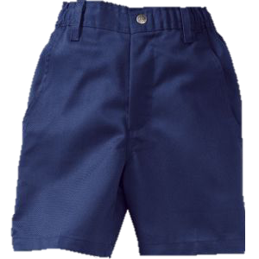
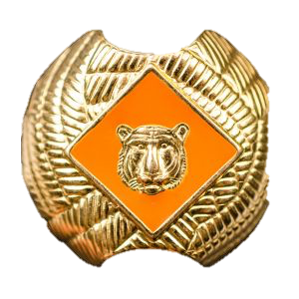
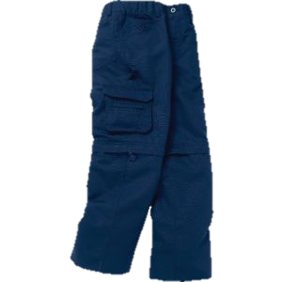
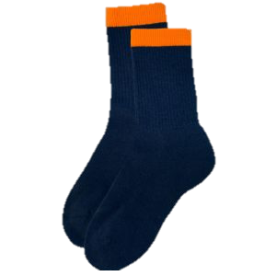
Uniform

Slide 7
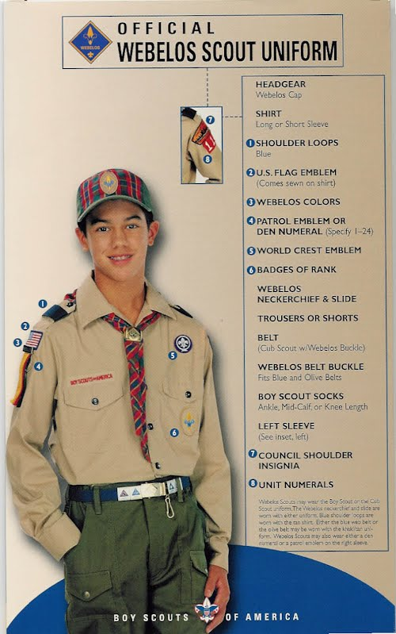
Uniform

Slide 8
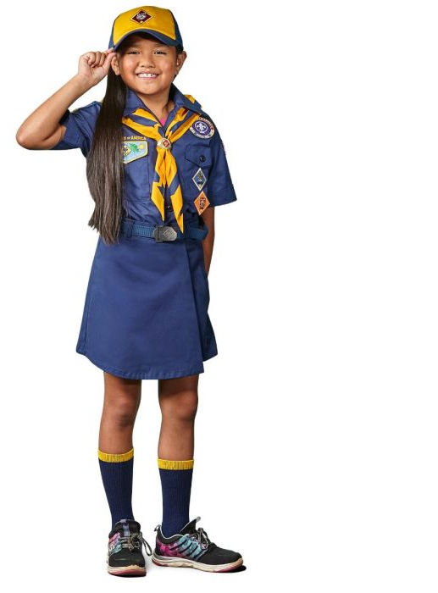

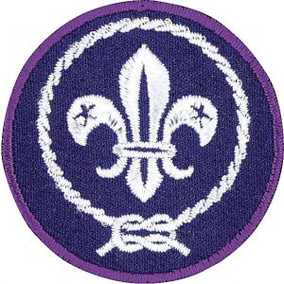

Insignia

Slide 9
Cub Scout Insignia Guide Page 1

Slide 10
Cub Scout Insignia Guide Page 2

Slide 11
Handbook
We provide the handbook each year for your scout as part of your annual fees.

